Slide 1
Power System Planning
Muhammad Kamran, PhD
Professor, EED, UET
mkamran@uet.edu.pk

Slide 2
Course Evaluation
Quiz (s) 3-4 15%
Mid Term Exam 30%
Assignments 3-4 10%
End Term Exam 40%
Presentations 5%
CLOs will be followed as per course which will be mapped on required PLOs

Slide 3
Text Book
Electric Power Distribution Engineering By Turan Gonen, 2nd Edition
Reference Books and Material: Internet or any other related material
Presentation Guidelines: Any relevant topic with practical implementations in field by the presenters

Slide 4
Lecture Contents
Introduction to Course
Distribution System Planning
Calculations for the Generation planning and cable pricing
Factors Affecting the System Planning
Distribution planning
Basic Definitions

Slide 5
Introduction
An Electric power system includes Generation, Transmission and Distribution of Energy
The electric utility industry grew very rapidly and the generation stations and transmission and distribution networks spread across the entire country
Considering energy needs and available fuels that are forecasted for the next century, energy is expected to be increasingly converted to electricity
Operation and maintenance is major part of power system planning

Slide 6
Distribution System Planning
System planning is essential to ensure the 100% safe and appropriate power system operation
In the past, the planning for the other portions of electric power system and distribution system frequently had been authorized at the company division level without review of or coordination with long range plans
As a result increasing cost of energy, equipment and labor etc is encountered
The distribution system is particularly important to an electrical utility for two reasons; (i) its close proximity to ultimate customer and (ii) its investment cost

Slide 7
If distribution system of power supply system is the closest to customer, its failures affect customer more directly than for example failure on transmission and generating systems, which usually do not cause customer service interruptions
Therefore, distribution system planning starts at the customer level
The demand, type, load factor and other customer load characteristics dictate the type of distribution system required
Load factor calculation is shown in next slide

Slide 8
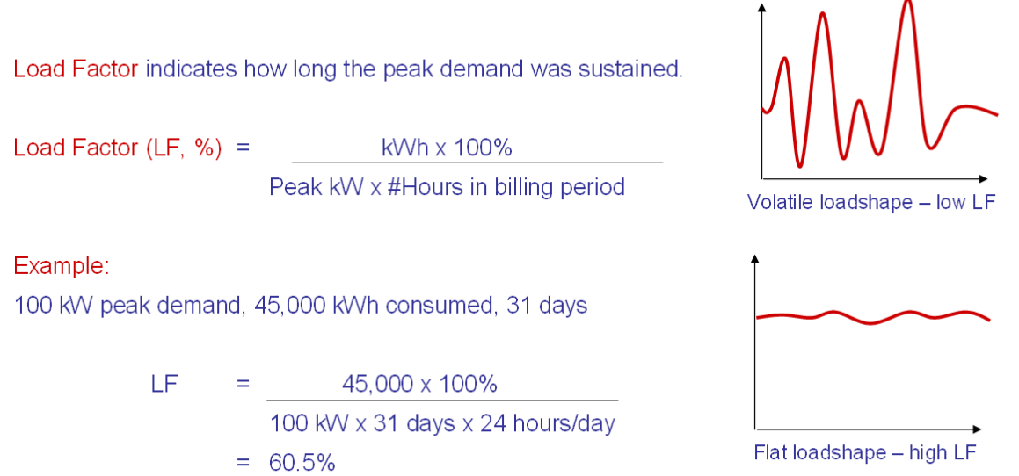
Load Factor

Slide 9
If your peak demand is measured in kVA, you should convert it to kW by multiplying the kVA figure by the on-peak power factor for your building (if you know it)
If not, a power factor of 90% is a reasonable estimate for most buildings that do not have power factor correction capacitors installed
Values for LOAD FACTOR vary widely with the types of loads and operating schedules
Some industrial loads dip to 20% or lower, while commercial buildings commonly see 40% to 70%
Of course, you can expect seasonal swings if you have electric cooling or heating systems.

Slide 10
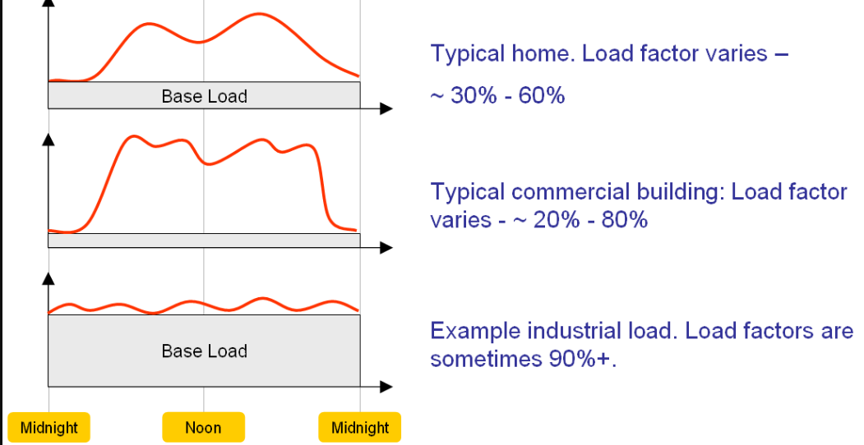

Slide 11
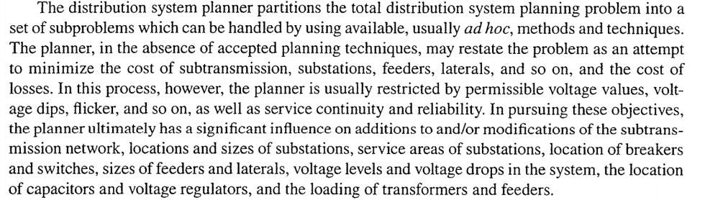
Reference- Text Book

Slide 12
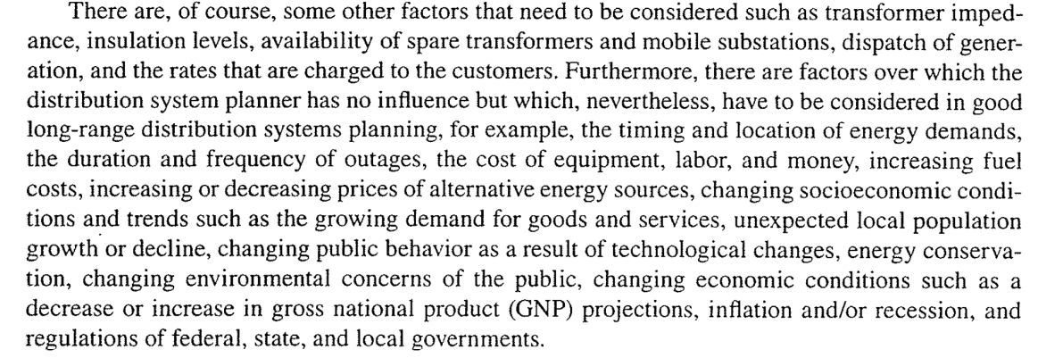
TEXT BOOK

Slide 13
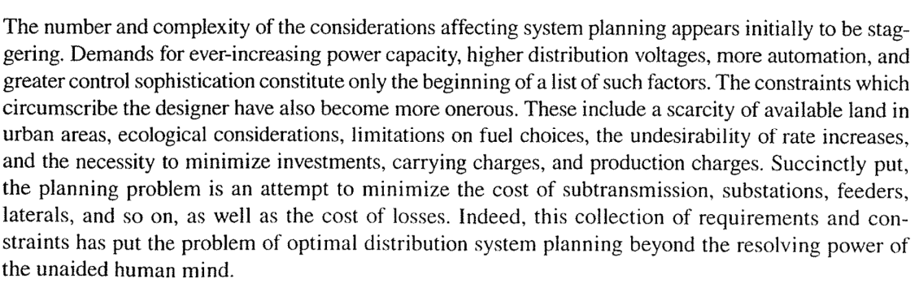
Factors Affecting System Planning

Slide 14
Load Forecasting
The load growth of the geographical area served by a utility company is the most important factor influencing the expansion of the distribution system
Therefore, forecasting of load increases and system reaction to these increases is essential for planning process
Here are two common time scales of importance to load forecasting; long range with time horizon in order of 15-20 year away and short range with time horizon in order of 5 years away
Next slide gives factors affecting Load forecasting;

Slide 15
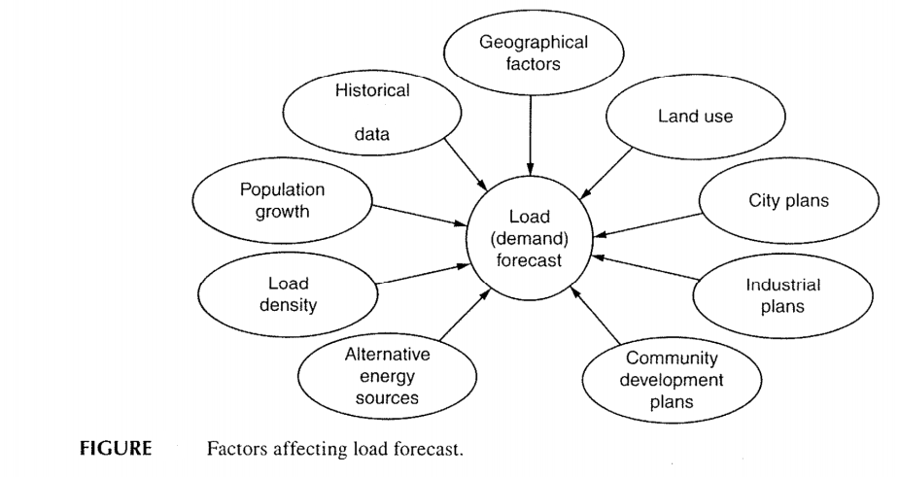

Slide 16
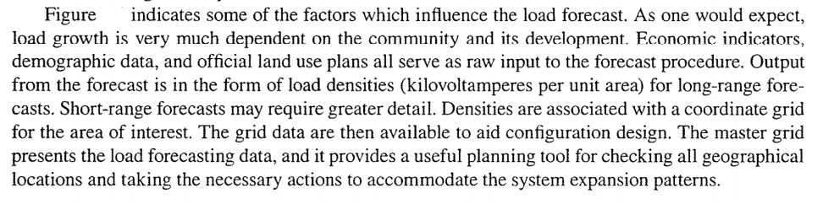
TEXT BOOK

Slide 17
Substation Expansion
Fig in next slide presents some of the factors affecting substation expansion
The planner makes a decision based on tangible or intangible information.
For example, the forecasted load, load density and load growth may require a substation expansion or a new substation construction
For expansion present system configuration, capacity, and the forecasted loads can play major roles

Slide 18
Substation Site Selection
Fig shows factors that affect substation site selection
The distance from load centers and from existing sub transmission lines as well as other limitations, such as availability of land, its cost, and land use regulations are important
Service region is the area under evaluation defined as the territory of the utility
An initial screening is applied by using a set of considerations like safety, engineering system planning, institutional economics etc.

Slide 19
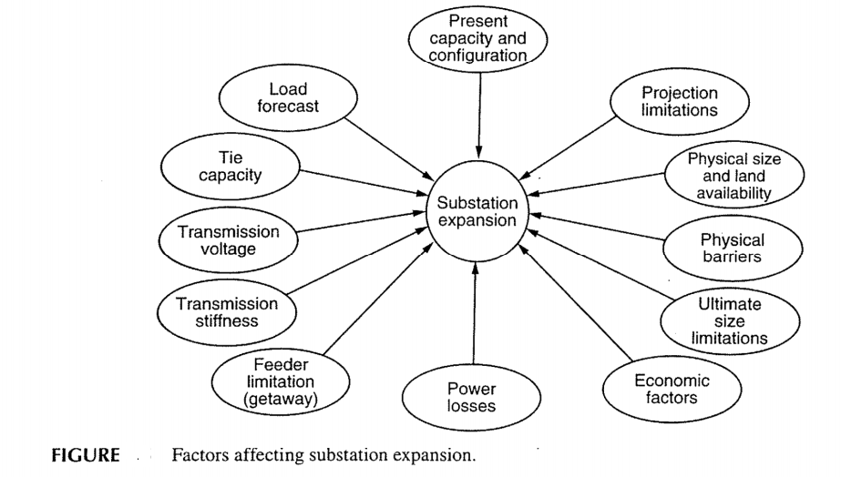

Slide 20
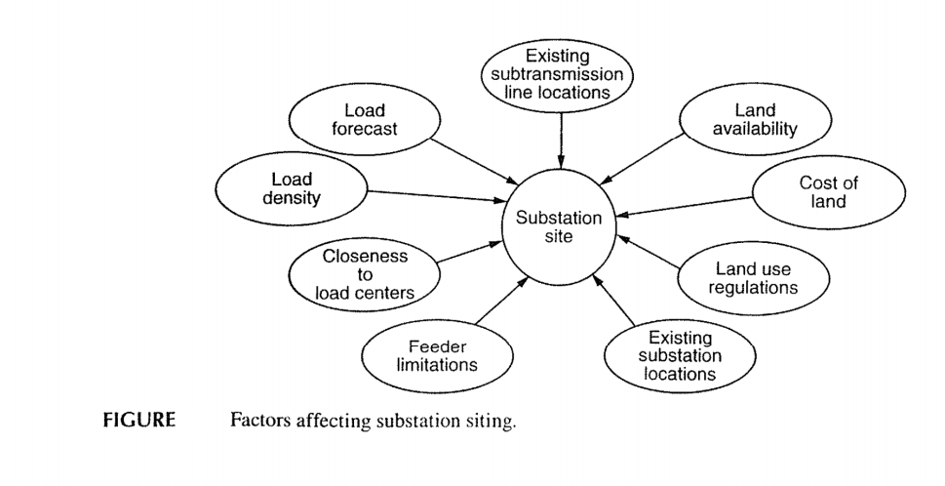

Slide 21
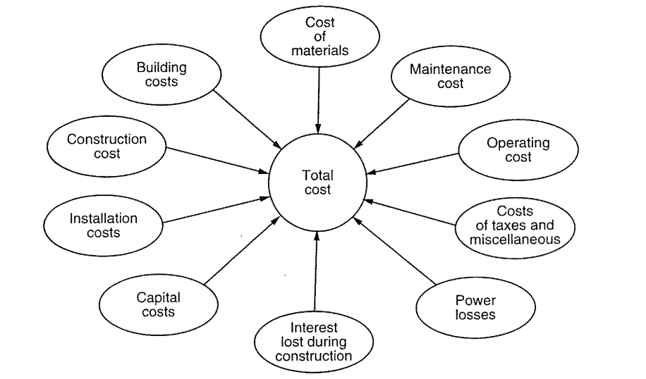
Factors Affecting cost

Slide 22
Distribution system planning- Technical aspects
One of the essential elements in distribution system planning is the location of the load centre where the primary substation is situated
Establishment of load centre or primary substation, particularly in a densely populated area, must be prepared in long-term plan, for example, in a 10-year plan
The outlets from the primary substation will then supply the required electrical energy to the nearby customer loads
Customer substations will then further transform the distribution high voltage to the LV.

Slide 23
Basic Design Criteria
Distribution network refers to those 22kV or 11kV network supplying electricity to customers through cable or Overhead Line (OHL)
From primary substation to various customer substations, various types of network configurations are possible, for example, single-end fed, double-end fed and closed ring network arrangement
In the customer substation, it normally consists of the step down transformer to LV; it may also contain HV circuit breaker(s), ring main units

Slide 24
Additional consideration is the availability of remote control facilities to enhance the security of supply
In transmission network, the typical design concept is the ‘N-1’ reliability application
‘N-1’ is referred to as any single component failure in the supply network will not affect the electricity supply
Hence in the case of a failure of a transmission line, or a transformer connected to the distribution primary substation from the transmission source, the supply to the distribution network will not be affected

Slide 25
It is normally achieved with suitable protection and associated inter-tripping or switching scheme to the distribution incoming from the transmission network
Hence, the primary substation is thus designed to supply a firm load based on the calculation of ‘N-1’ criteria
On the other hand, the distribution network connected from the primary source substation will depends on the geographical locations of the customer substations

Slide 26
Ring Main Unit
In an electrical power distribution system, a ring main unit (RMU) is a factory assembled, metal enclosed set of switchgear used at the load connection points of a ring-type distribution network.
It includes in one unit two switches that can connect the load to either or both main conductors, and a fusible switch or circuit breaker and switch that feed a distribution transformer.
The metal enclosed unit connects to the transformer either through a bus throat of standardized dimensions, or else through cables and is usually installed outdoors.

Slide 27
Ring main cables enter and leave the cabinet
This type of switchgear is used for medium-voltage power distribution, from 7200 volts to about 36000 volts.

Slide 28
Types of Distribution Networks
Single-end radial fed
Single-end radial fed refers to a number of customer substations or pole-mounted substations are connected to the primary substation
The supply security is the lowest as any single point failure will result in the loss of supply to the customer substation
Similarly, any single failure in the customer substation will result in loss of supply to the customer
In case of fault, the supply restoration will depend on the fault repair time.

Slide 29
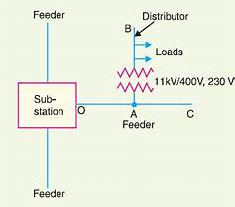

Slide 30
Double-end fed with an NO Point
To provide a higher supply security, the customer substations can be fed from two sources as shown in fig
The customer substation is normally supplied from a single end and in the case of loss of supply from the one source end, for example due to a component failure, the NO (normally open) point can be closed to restore supply after the faulty portion of the component is isolated
The supply restoration will be quicker and is not directly depending on the fault repair time
The customer substation may consist of Ring Main Unit (RMU) and equipped with earth fault indicator as shown below

Slide 31
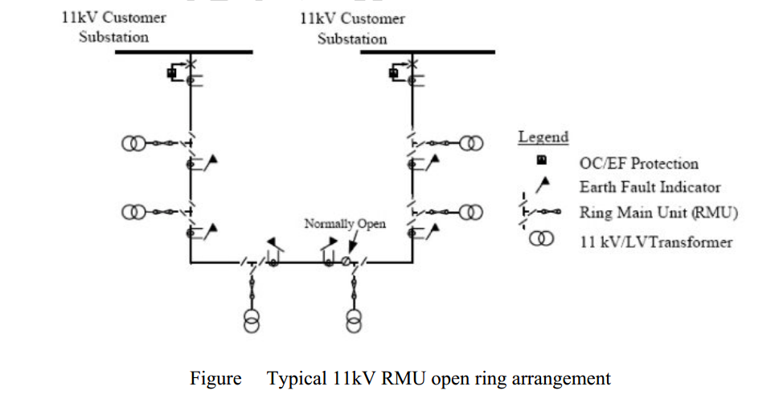
Double-end fed with an NO point

Slide 32
This configuration results in loss of supply in case of fault in the RMU circuit since the controlling circuit breaker at the controlling/customer substation will trip to isolate the faulty circuit

Slide 33
Ringed Network Arrangement
A typical customer substation in a ring-configured network contains two feeders and one transformer feeder
The former have circuit breakers and cable connecting to other substations while the later has circuit breaker and cable connecting to 11kV/LV transformer
A typical ringed network arrangement is shown in fig

Slide 34
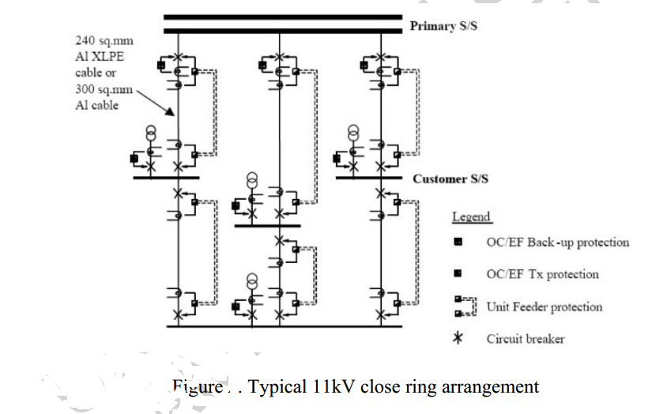

Slide 35
Closed Ring Operation
Closed-ring operation of distribution grids has several advantages over more common distribution grid configurations incorporating normally-open points
As power flows are able to naturally balance out between feeders of a ring shaped distribution grid, it is expected that peak loading will be reduced, and with that, grid losses
As such, investment costs can be postponed or avoided and operational costs can be reduced due to lower grid losses

Slide 36
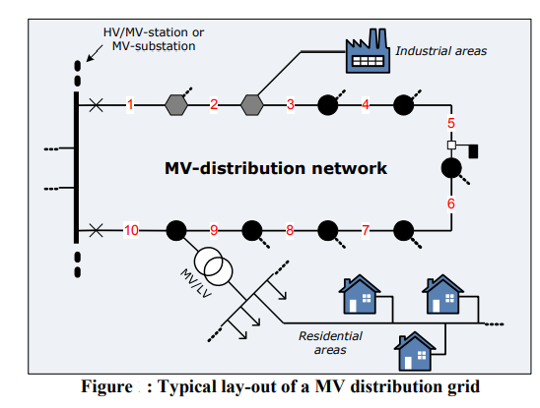

Slide 37
Typically distribution grids are structured according to the lay-out depicted in Figure
Medium voltage distribution rings are usually fitted with a normally-open point (NOP), splitting the ring into two separate feeders from an electrical-technical point of view
The purpose of the NOP is to ensure selectivity for protection systems and reduce the impact of faults in the grid by limiting the number of customers that are affected when protection trips
However, on the downside, the NOP might indirectly incur additional grid losses, by obstructing an optimal power flow

Slide 38
Basic Understanding
To understand some of the problems that the power industry faces let us briefly review some of the characteristic features of generation and transmission
The power system must, be capable of matching the output from generators to the demand at anytime at a specified voltage and frequency
The difficulty encountered in this task can be imagined from the fact that load variations over a day comprises three components-a steady component known as base load; a varying component whose daily pattern depends upon the time of day; weather, season, a popular festival, etc. and a purely randomly varying component of relatively small amplitude

Slide 39
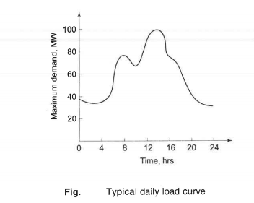
Figure shows a typical daily load curve.
The characteristics of a daily load curve on a gross basis are indicated by peak load and the time of its occurrence and load factor defined as;
Average load/ maximum (peak) load = less than unity

Slide 40
The average load determines the energy consumption over the day, while the peak load along with considerations of standby capacity determines plant capacity for meeting the load
A high load factor helps in drawing more energy from a given installation

Slide 41
Tariff Calculation
Problem 1 Comparing two tariffs of industrial load….

Slide 42
Discussion will be continued…..diversity factors and problems related to average load, installed capacity base load etc.

